Slide 1



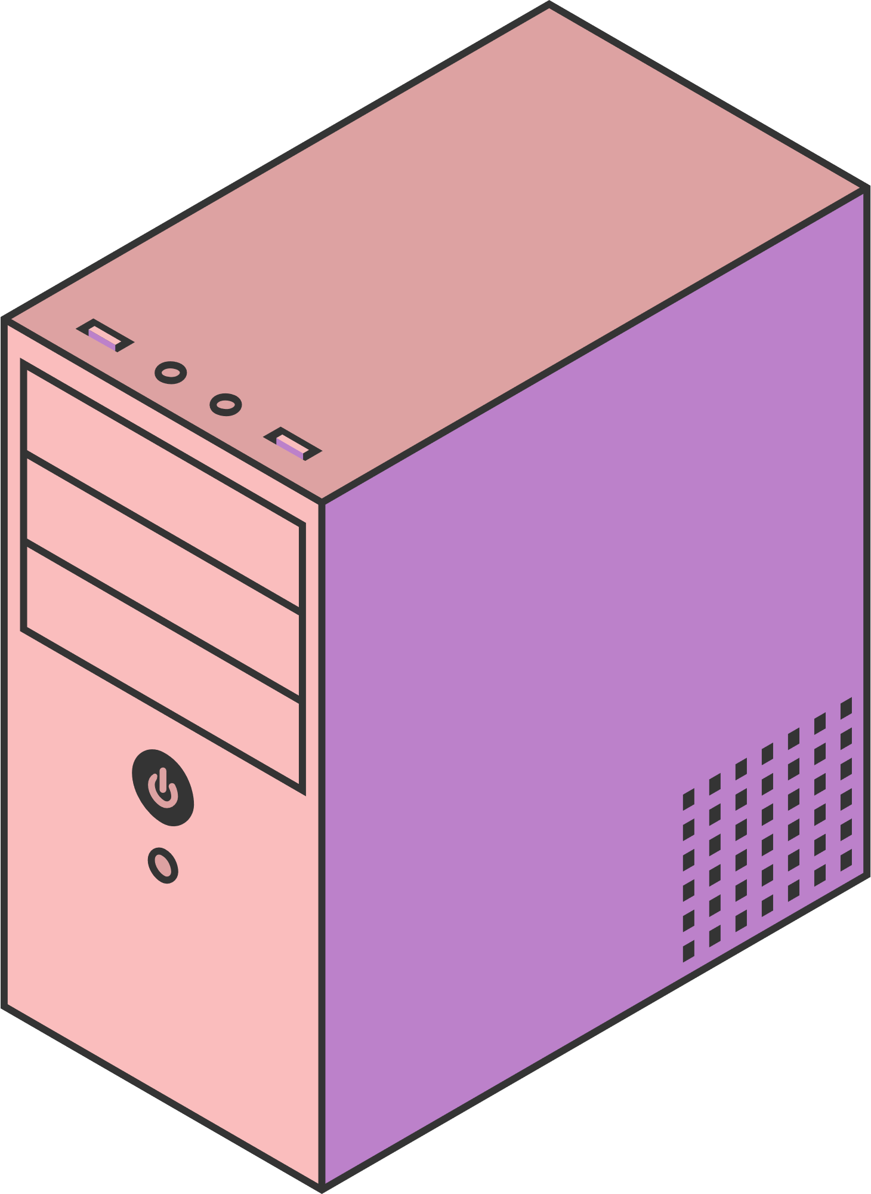
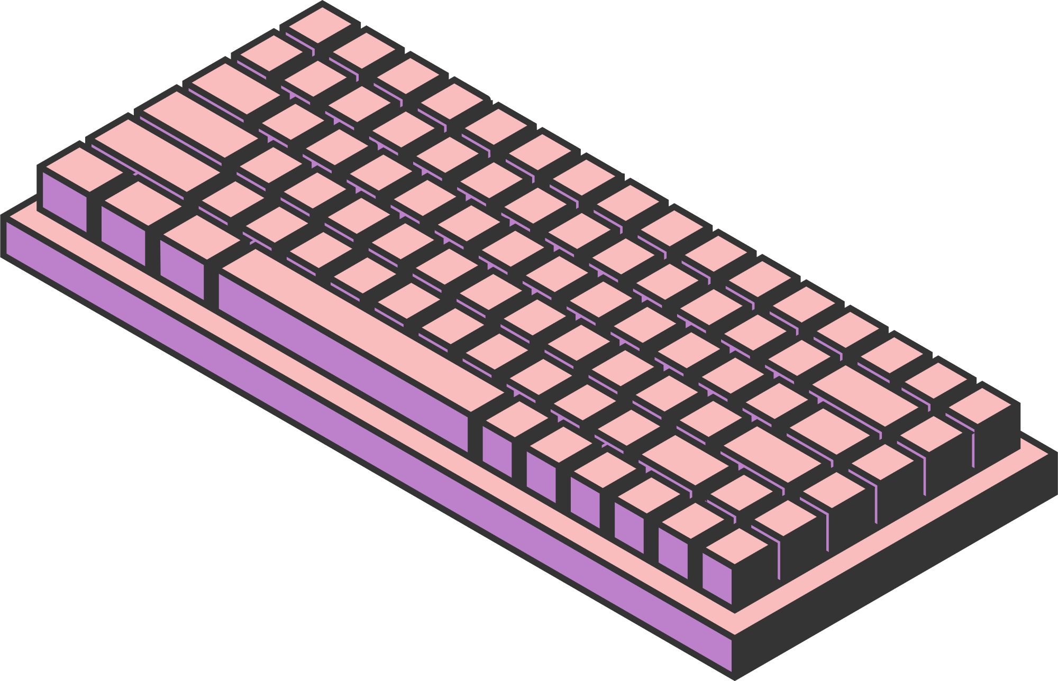
HOME
SERVICE
ABOUT US
CONTACT US
MEDICAL LABORATORY SYSTEM
Presented by:
Nour Menshawy, Jomana Elgammal and Batoul Gamal.
Page 01

Slide 2

HOME
SERVICE
ABOUT US
CONTACT US
TABLE OF CONTENTS
Designing the ERD.
4. The relational.
2. Writing the SQL schema.
3. Inserting Data into table.
Page 03

Slide 3

HOME
SERVICE
ABOUT US
CONTACT US
INTRODUCTION
This project is a complete medical laboratory database system consisting of a structured MySQL relational schema. We created and implemented the database, and the system facilitates the storage of laboratory, patient, medical test, test result, and test component (materials) data.
Page 02

Slide 4
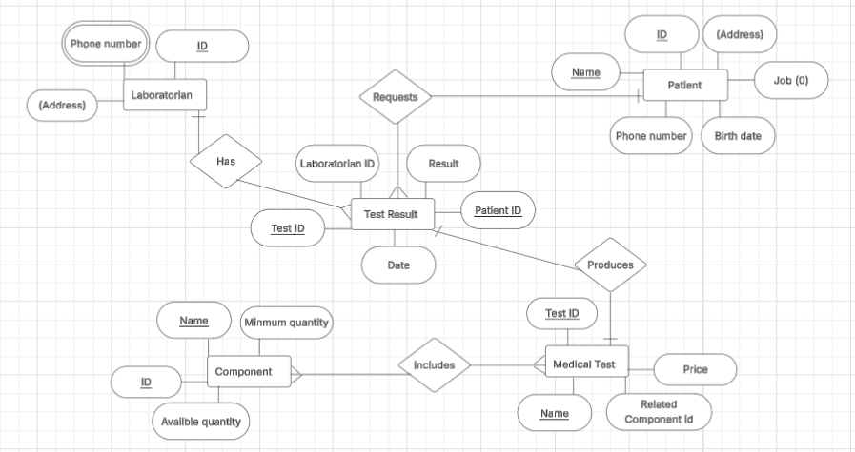
ERD DIAGRAM
HOME
SERVICE
ABOUT US
CONTACT US
Page 06

Slide 5
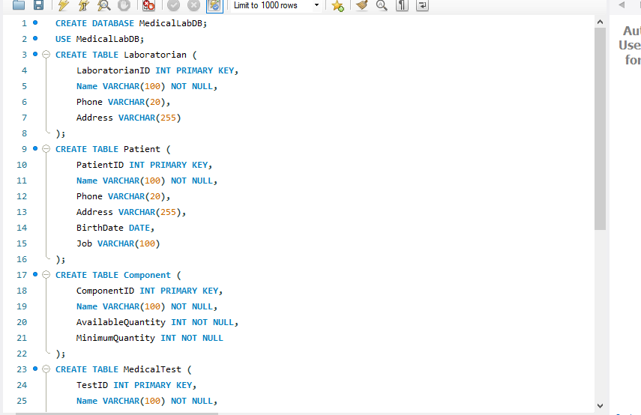
HOME
SERVICE
ABOUT US
CONTACT US
SQL SCRIPT/SCHEMA
Page 04

Slide 6
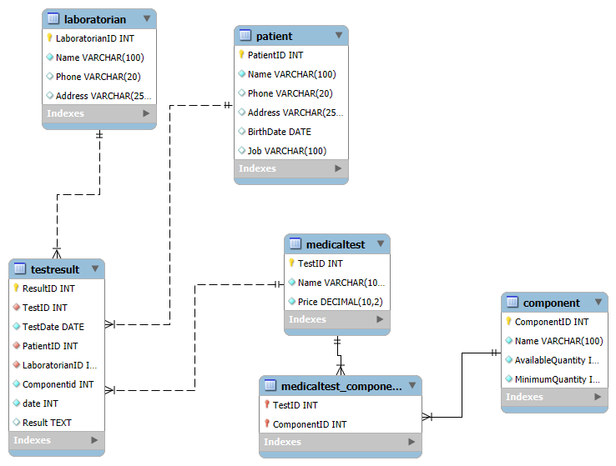

RELATIONS
HOME
SERVICE
ABOUT US
CONTACT US
Page 04

Slide 7
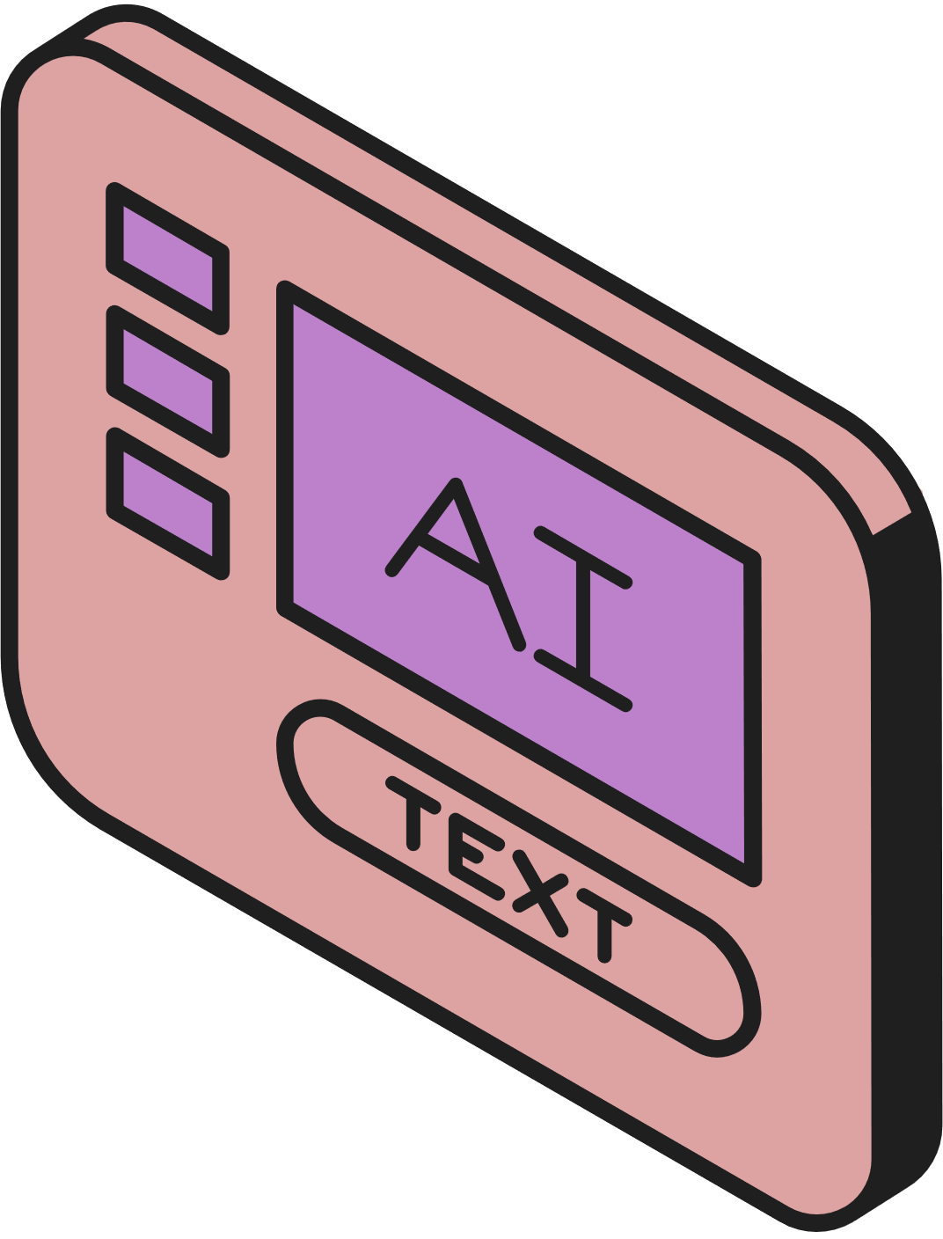

HOME
SERVICE
ABOUT US
CONTACT US
EXAMPLES OF
CARDINALITY
One component can be linked to many medical tests.
One patient can have many test results.
One laboratorian can handle many test results.
One medical test can be used in many test results.
Page 07

Slide 8
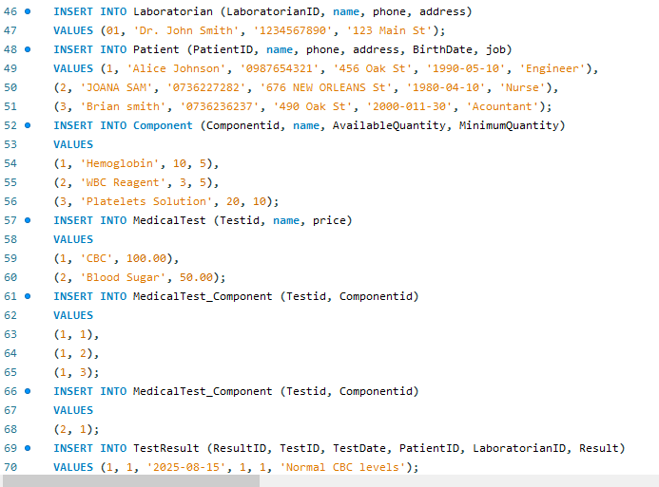
HOME
SERVICE
ABOUT US
CONTACT US
INSERTING DATA INTO TABLES
Page 04

Slide 9
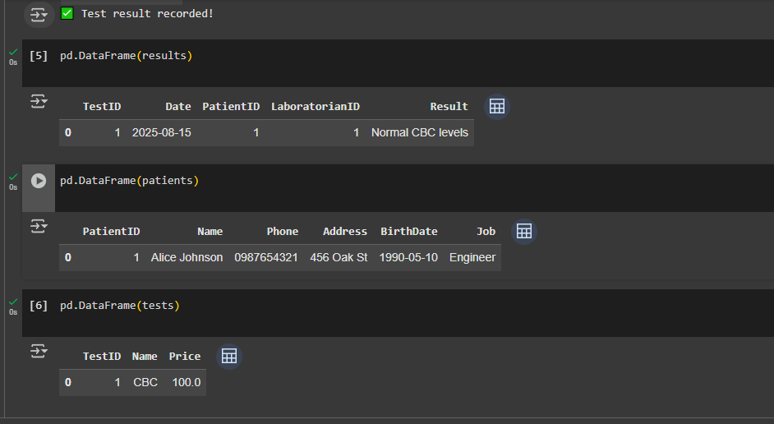
THE UI FOR DB
ADD OR VIEW DATA DYNAMICALLY
HOME
SERVICE
ABOUT US
CONTACT US
Page 04

Slide 10
HOME
SERVICE
ABOUT US
CONTACT US
THANK YOU
Page 10

